Slide 1
UNIT-II Advanced water treatment methods
By
P.RAVI KISHORE
Dept of Civil Engineering
Aditya Engineering College(A)
Surampalem.

Slide 2
Water treatment by advanced treatment methods

Slide 3
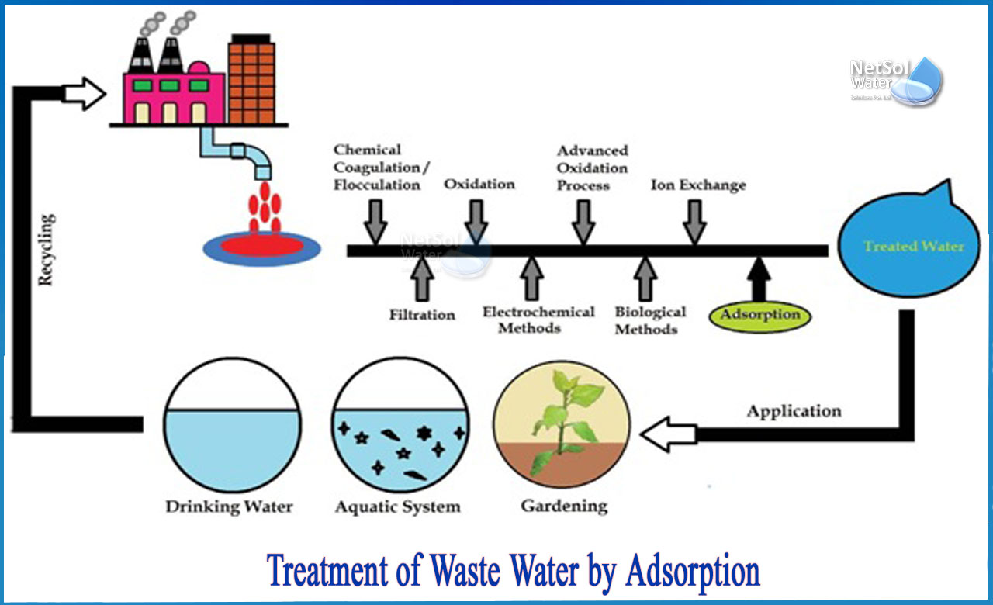
Adsorption

Slide 4
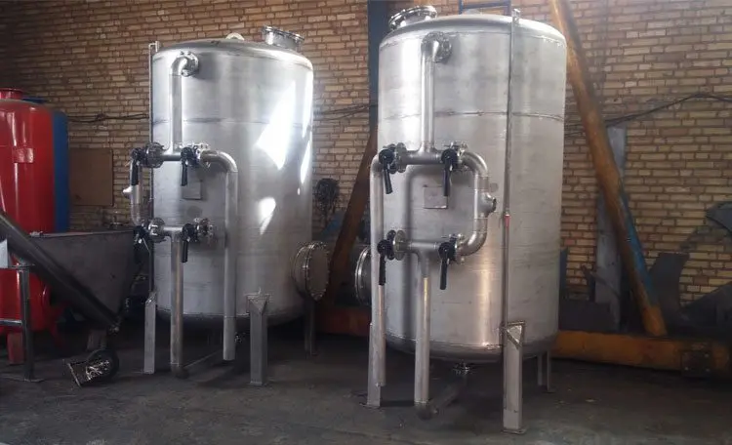
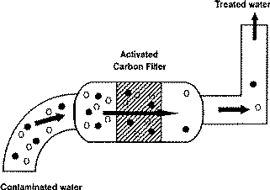
Adsorption

Slide 5
Adsorption with active carbon is frequently used as tertiary purification for the removal of organic micropollutants and COD from wastewater, as well as metals in organic complexes to a lesser extent.
Adsorption is a wastewater purification technique used to remove a variety of compounds from industrial wastewater. Adsorption is most commonly used to remove non-degradable organic compounds from groundwater, drinking water preparation, process water, or as a tertiary cleansing step after biological water purification.
Adsorption occurs when molecules in a liquid bind to the surface of a solid substance. Adsorbents have a large internal surface area that allows for adsorption.
Active carbon is by far the most commonly used adsorbent, and it is especially well-suited to the removal of a polar compounds.
Adsorbents are employed in specific applications
Zeolites, whether natural or synthetic (alumina-silicate-polymers)
Naturally occurring clay minerals
Silica gel and aluminum that has been activated
Silicic acid

Slide 6
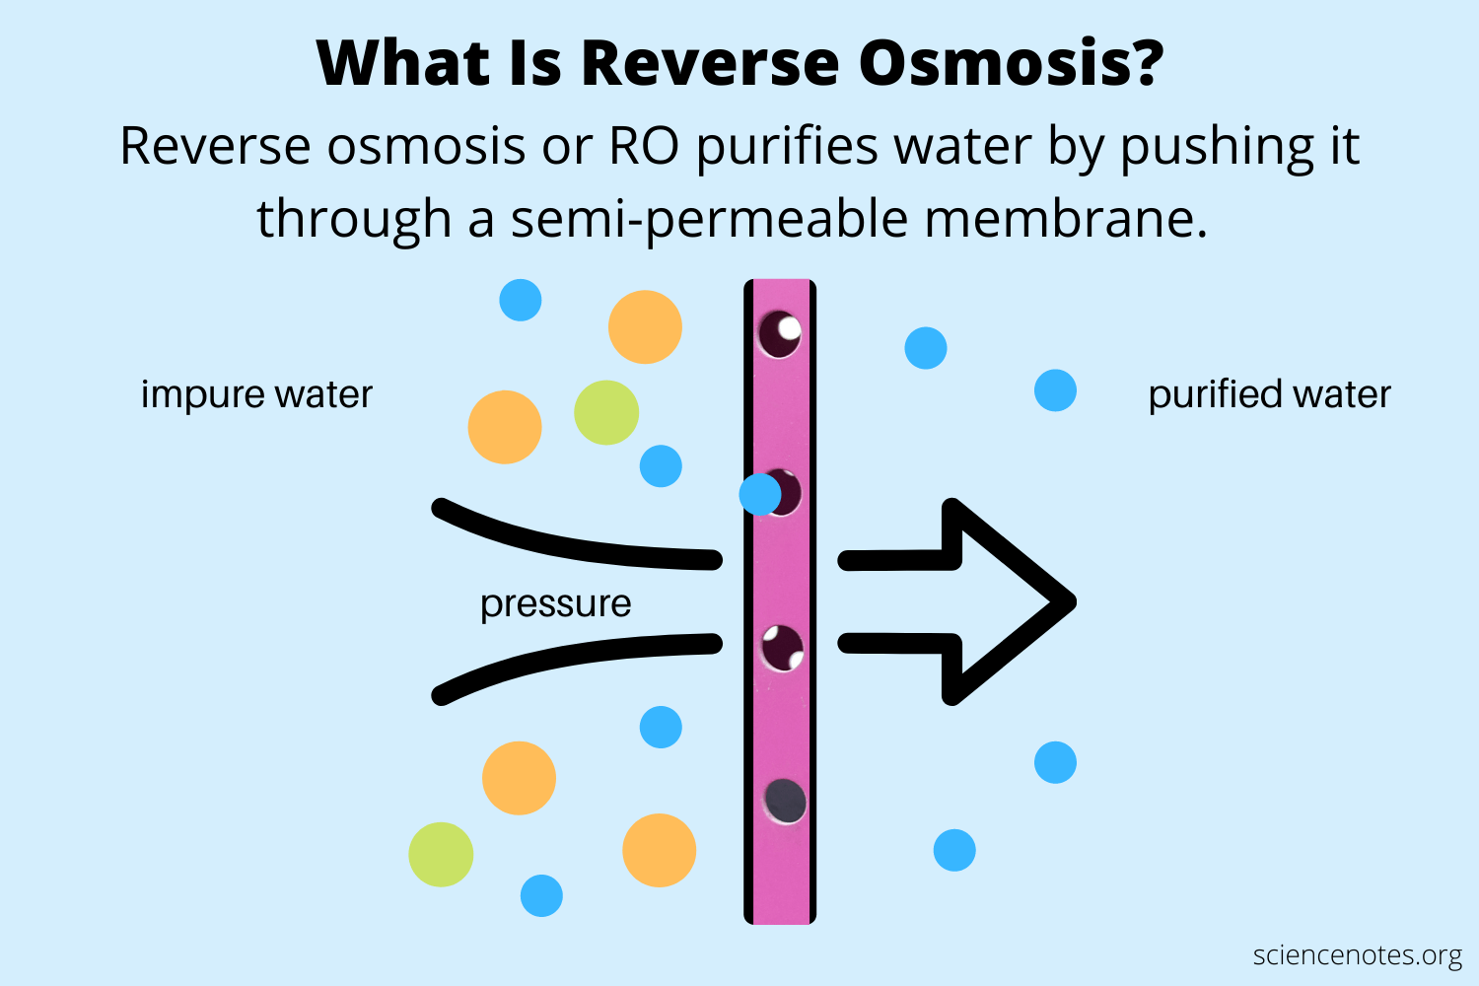
Reverse Osmosis

Slide 7
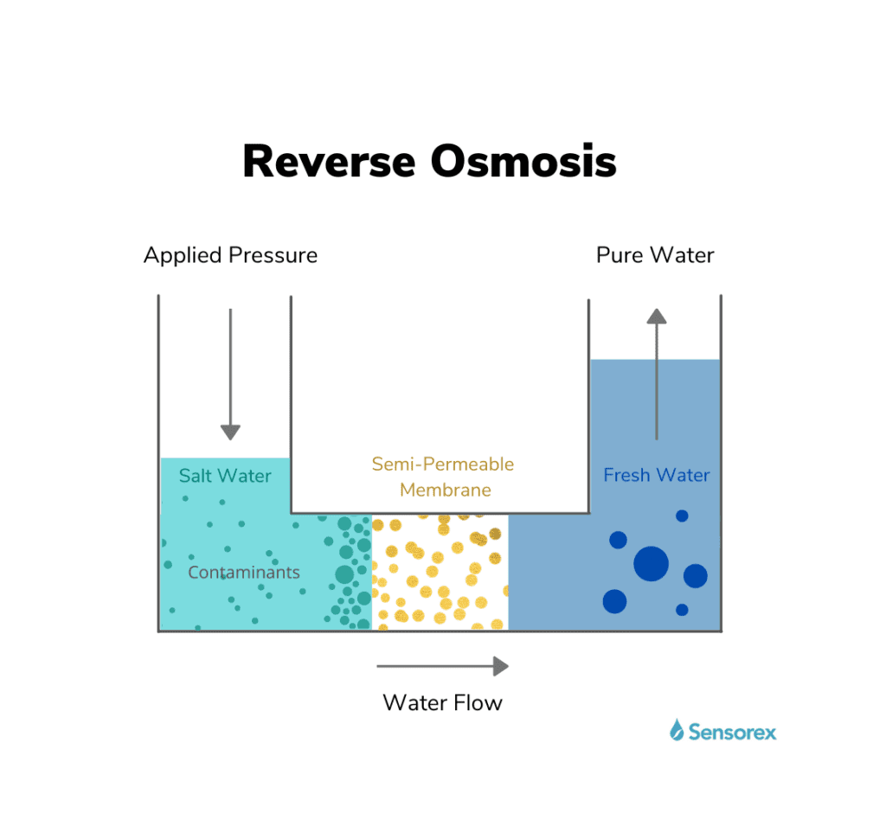
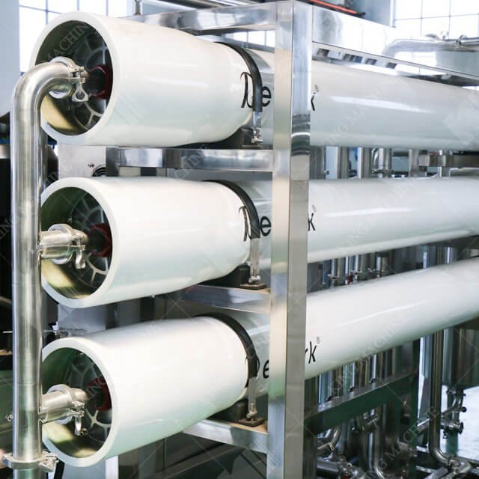

Slide 8
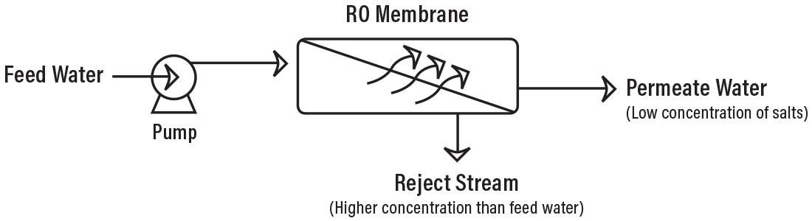
RO is considered as one of the most important water purification technologies. The contaminants present in water are removed by pushing water under pressure through a semi-permeable membrane. Pure water is thus squeezed out which is fit for drinking. RO is also used in the desalination of seawater. RO is a reliable source for obtaining potable water.
The process eliminates dissolved and suspended impurities, even bacteria.
The membrane is small enough to allow the solvent molecules to pass but does not allow large ions or molecules to pass through its pores.
Polymer membranes are used for the desalinization of seawater.
Cellulose acetate is often used as a semi-permeable membrane. It allows water molecules to pass but is impermeable to impurities.
It finds application in the military, wastewater purification, food industry, landfill leachate purification, etc.

Slide 9
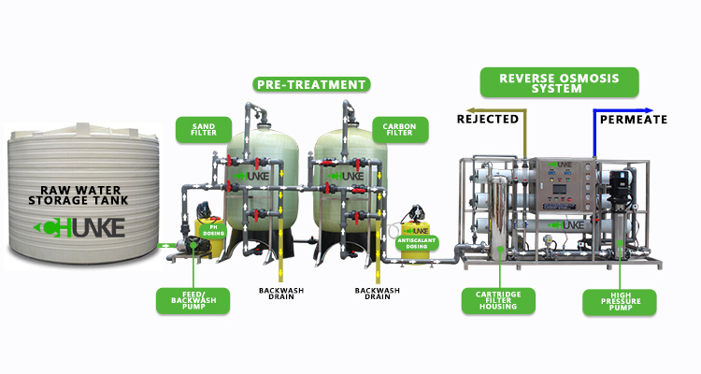

Slide 10
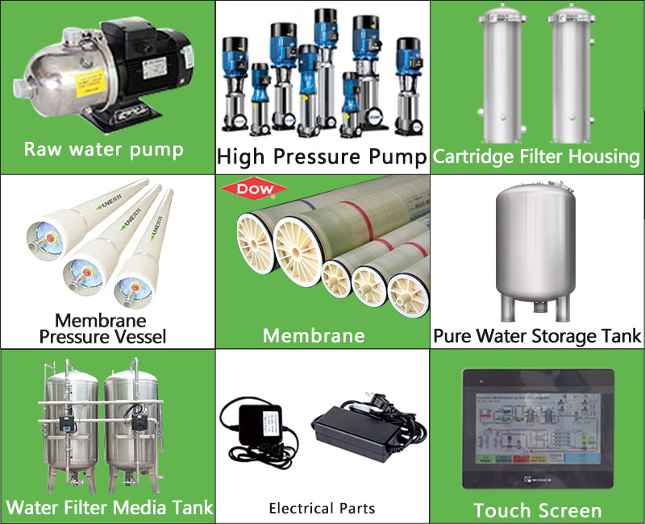

Slide 11
Ultrafiltration
Filtration is the process of removing particulates from water by forcing it through a porous medium. This porous media could be natural, like sand, gravel, or clay, or it could be a membrane wall made of a variety of materials. The process of settling large particles prior to filtration is known as sedimentation.
Ultrafiltration (0.01 micron) would eliminate larger particles, as well as some viruses. Neither microfiltration nor ultrafiltration can remove dissolved compounds unless they are first adsorbed (with activated carbon) or clotted (with alum or iron salts).
WHAT IS REVERSE OSMOSIS
The pore size of Reverse Osmosis filters is roughly 0.0001 micron. Water is practically pure after flowing through a RO filter. Reverse Osmosis not only cleanses all organic molecules and viruses, but it also removes the majority of minerals in the water.
 | It converts 4/5 gallons into waste water. | It doesn't produce any waste. In fact, it can be used to make potable wastewater.
 | It requires a storage tank as it has slow filter speeds. | It does not require a storage tank as it filters one gallon of water per minute.
 | RO needs a minimum 50 psi to function properly. | UF can operate smoothly under low pressure.

Slide 12
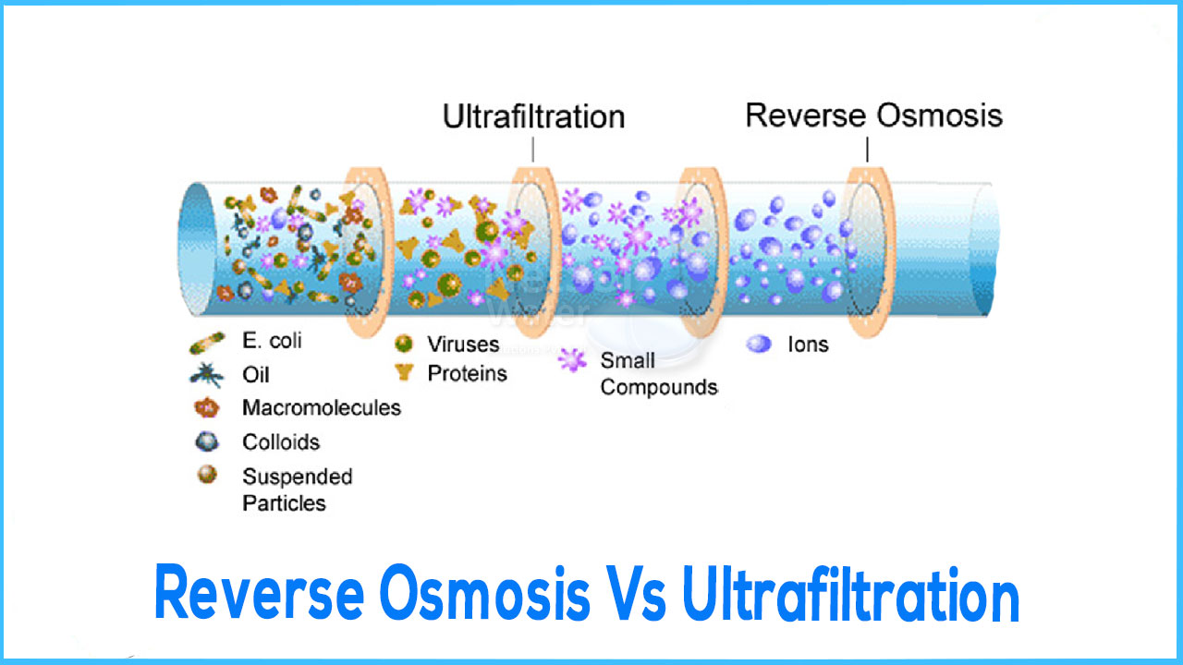

Slide 13
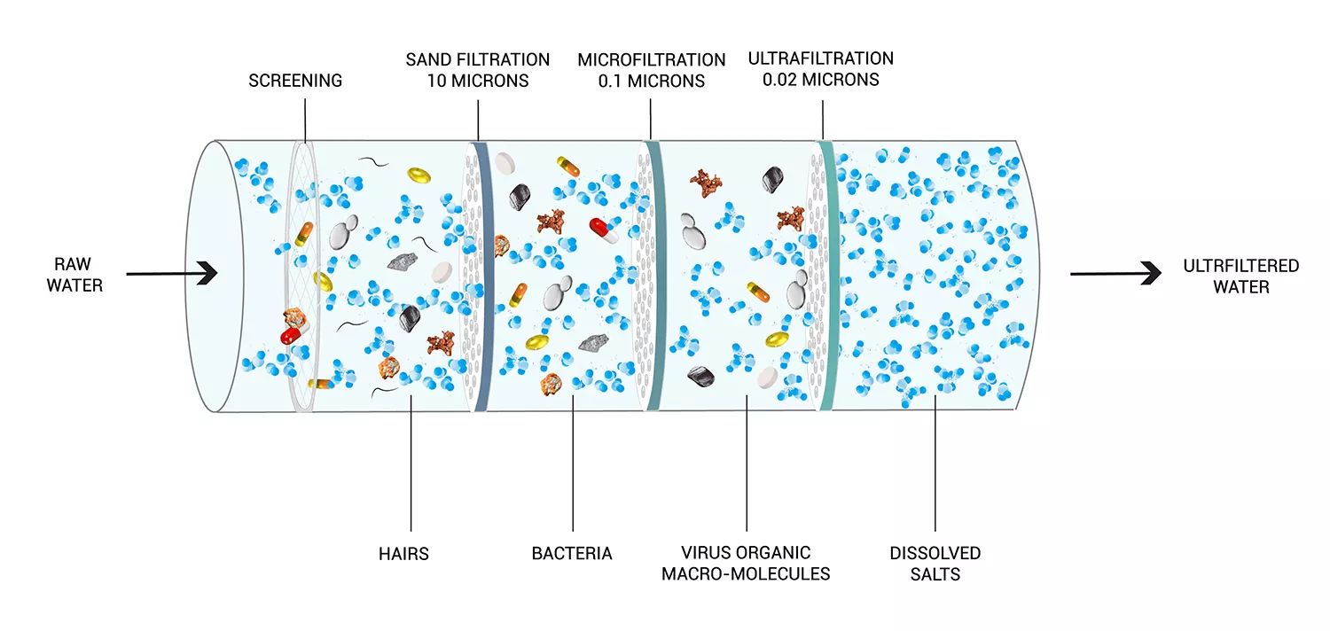

Slide 14
Advantages of Ultrafiltration System
1: Zero Power Requirement
The Ultrafiltration System operates without the use of electricity. Water can be filtered using natural pressure with this technique. Choose a zero-power water purifying procedure instead of worrying about power outages or paying electricity costs.
2: Viruses and bacteria are eliminated
By pushing water through a membrane, ultrafiltration eliminates particle materials. As a result, it not only kills all bacteria and viruses, but also eliminates their eggs from the water, ensuring that the water is clean and safe.
3: Deep cleaning
Even dirty muddy water may be purified with the Deep Cleaning Ultrafiltration System. In comparison to conventional filtration systems, it can readily remove all solid particle matter and germs from filthy water. The ultrafiltration membrane can quickly cleanse even the dirtiest water, making it safe to drink.
4: Ensures the purest kind of drinking water
The Ultrafiltration System will always generate safe drinking water. Because the ultrafiltration membrane is extremely robust, no small or large particle matter can flow through it.
5: System with Low Maintenance and High Performance
Water purifiers that use the Ultrafiltration System don't need to go through a long-term maintenance routine and can last for many years. The manual flushing device in these purifiers removes all of the trapped germs and muck, ensuring that the purifier operates at peak performance for at least eleven years.
6: Excellent Purification
Most water filtration systems, with the exception of the Ultrafiltration system, use chlorine treatment to kill and extract microorganisms from the water. However, the eggs (cysts) cannot be removed with this procedure. The Ultrafiltration System, on the other hand, removes the chlorine-resistant eggs (Cysts) of gastrointestinal parasites such as cryptosporidiosis, giardiasis, and amoebic illness, resulting in pure drinkable water.

Slide 15
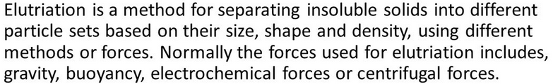
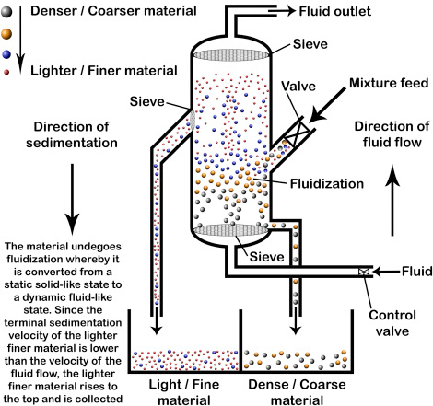

Slide 16
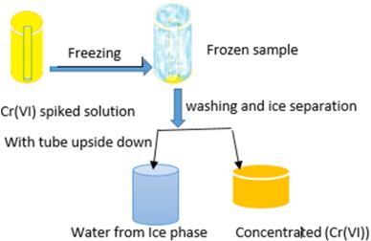
Freezing
Freezing technology can be utilized in waste water treatment. When waste water freezes, it is purified through the formation of a cleaner layer of ice. The clean layer of ice can be removed from the rest of the waste water, and the remaining waste water is more concentrated. The new energy-efficient method of purification is based on the natural freezing process of water: energy is required only for breaking the ice and transporting it from the waste water pool.
In practice, this method could be used by leaving waste water from mines to freeze in special pools under the open sky, after which the cleaner part could be removed by breaking the ice. After that the ice would be taken away using a machine designed for that purpose to another pool where the treated waste water would be recycled, or undergo further treatment using membrane filtration, for example, for the needs of various processes. Recycling water from the industrial process would reduce the amount of fresh water that is used

